Slide 1
What is an Operating System?

Slide 2
What is an Operating System? (User’s view)
A program that acts as an intermediary between a user of a computer and the computer hardware
Defines an interface for the user to use services provided by the system
Creates an environment for the user

Slide 3
What is an Operating System? (User’s view)
Abstract Machine
Hides complex details of the underlying hardware
Provides common API to applications and services
Simplifies application writing
Command Interpreter
Part of a OS that understands and executes commands that are entered interactively by a human being or from a program
Shell

Slide 4
Why is abstraction important?
Without OSs and abstract interfaces, application writers must program all device access directly
load device command codes into device registers
understand physical characteristics of the devices
Applications suffer!
very complicated maintenance and upgrading
no portability

Slide 5

What Operating Systems Do (User’s view)
Depends on the point of view
Single user system
Users want convenience, ease of use
Don’t care about resource utilization
Optimized for single user experience

Slide 6
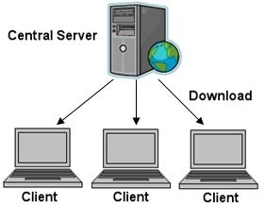
What Operating Systems Do (User’s view)
Depends on the point of view
Shared computer such as mainframe must keep all users happy
Response time minimum
Keep all the users happy
Shared CPU, memory

Slide 7
What Operating Systems Do
(Systems view)
OS is a resource allocator
Manages all resources
Decides between conflicting requests for efficient and fair resource use
OS is a control program
Controls execution of programs to prevent errors and improper use of the computer

Slide 8
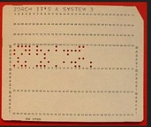
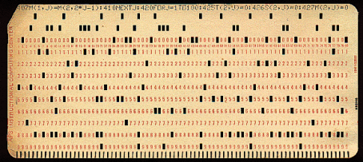
Types of Systems
Batch Systems
Multiple jobs, but only one job in memory at one time and executed (till completion) before the next one starts
Operating system
User program
Jobs waiting

Slide 9
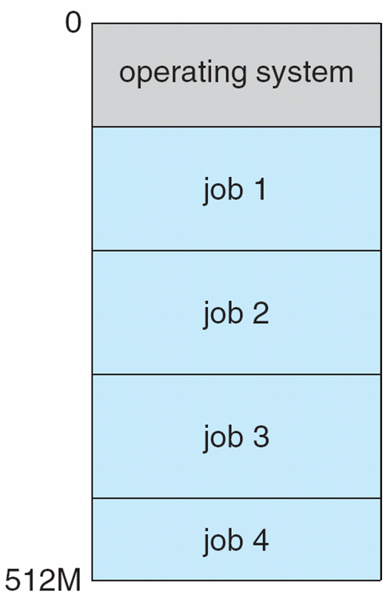
Types of Systems
Multiprogrammed Systems
Multiple jobs in memory, CPU is multiplexed between them
Single user cannot keep CPU and I/O devices busy at all times
When it has to wait (for I/O for example), OS switches to another job
Multiprogramming organizes jobs (code and data) so CPU always has one to execute
A subset of total jobs in system is kept in memory
One job selected and run via job scheduling
Effective resource utilization
Poor user experience

Slide 10



Types of Systems
Time-sharing Systems (multitasking)
logical extension of multiprogramming in which CPU switches jobs so frequently that users can interact with each job while it is running, creating interactive computing
Response time should be < 1 second
Each user has at least one program executing in memory
If several jobs ready to run at the same time  CPU scheduling
Low Response time
Low Response time

Slide 11
Role of Operating system
Computer system can be divided into four components:
Hardware – provides basic computing resources
CPU, memory, I/O devices
Application programs – define the ways in which the system resources are used to solve the computing problems of the users
Word processors, compilers, web browsers, database systems, video games
Users
People, machines, other computers
Operating system
Controls and coordinates use of hardware among various applications and users

Slide 12
Process Management
A process is a program in execution. Program is a passive entity, process is an active entity.
Process needs resources to accomplish its task
CPU time
Representation of process
Process has one program counter specifying location of next instruction to execute
Data structure (stores information of a process)
Many processes may be associated with the same program
Typically system has many processes
some user processes,
some operating system processes
Life cycle of a process
States
Arrival, Computation, I/O, I/O completion, termination

Slide 13
Process Management Activities
The operating system is responsible for the following activities in connection with process management:
Creating and deleting both user and system processes
Suspending and resuming processes
Process scheduling
Providing mechanisms for process synchronization
Providing mechanisms for process communication
Providing mechanisms for deadlock handling
R1
P1
R1
P1
R2
P2
R2
P2

Slide 14

Memory Management
All instructions and data in memory in order to execute
Translate the logical address to physical address
Process terminates => MMU declares that the memory space is available
Multiprogramming: Memory management manages several processes in memory
Optimizing CPU utilization and computer response to users
Ensure memory protection
Track illegal address
Memory management activities
Keeping track of which parts of memory are currently being used and by which process
Allocating and deallocating memory space as needed
Introduces Virtual memory
If the process size is bigger than the RAM size
Hardware support
Process
Memory Management Unit
CPU
Logical address
Physical address

Slide 15
File Management
OS provides uniform, logical view of information storage
Abstracts physical properties to logical storage unit - File
File => Collection of related information defined by the creator
Each medium is controlled by device (i.e., disk drive, tape drive)
Varying properties include access speed, capacity, data-transfer rate, access method (sequential or random)
User
Files (user’s view)
Device Driver
Mapping
Disk (sector, track)
Physical media

Slide 16
File Management
OS provides uniform, logical view of information storage
Abstracts physical properties to logical storage unit - file
Each medium is controlled by device (i.e., disk drive, tape drive)
Varying properties include access speed, capacity, data-transfer rate, access method (sequential or random)
OS implements the abstract concept of file by managing mass storage media (disk etc) and devices that control them
Files usually organized into directories
Access control on most systems to determine who can access what
File-System management
Creating and deleting files and directories
Primitives to manipulate files and dirs
Mapping files onto secondary storage

Slide 17
Disk Management
Usually disks used to store data that does not fit in main memory or data that must be kept for a “long” period of time
Most of the programs are stored on disk
Proper management is of central importance
Entire speed of computer operation depends on disk subsystem and its algorithms
OS activities
Storage allocation (logical blocks)
Free-space management
Disk scheduling

Slide 18
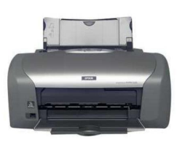
I/O Subsystem
One purpose of OS is to hide peculiarities of hardware devices from the user
I/O subsystem responsible for
Memory management of I/O including buffering (storing data temporarily while it is being transferred), caching (storing parts of data in faster storage for performance)
General device-driver interface
Drivers for specific hardware devices
I/O subsystem (general interface)
Device Drivers
I/O devices

